Slide 1
The Hitchhiker's Guide to the MSc Thesis

Slide 2
Topic selection
1) Check if according to the studies regulation you are eligible to start preparing your MSc Thesis (i.e. semester of your studies, courses that you have successfully passed)
2) Check the available MSc Thesis topics or if you have an idea for an assignment, find a potential supervisor and discuss it with him or her.
2) Agree with your supervisor professor and agree on your MSc Thesis topic and title.

Slide 3
MSc Thesis
registration
1) Download and fill in the MSc Thesis Application Form.
2) Send the form with your signature to your supervisor, asking for his/her signature.
3) Send the completed form to the MSc program secretariat.
4) Register your MSc Thesis on your current semester courses registration.

Slide 4
Writing the diploma
Thesis Document
1) Download the department’s MSc Thesis Template and start writing the thesis.
2) Keep track of the resources you use, so that you can reference them.
3) Make sure to follow the recommended text formatting explained within the template.
4) Be in contact with your supervisor at all times.

Slide 5
Unable to complete
the MSc Thesis
during the semester?
If you cannot complete the MSc Thesis within the semester, then before the semester ends and the soonest possible, meet with your supervisor and discuss if you
- need an extension or
- should resign from the MSc Thesis

Slide 6
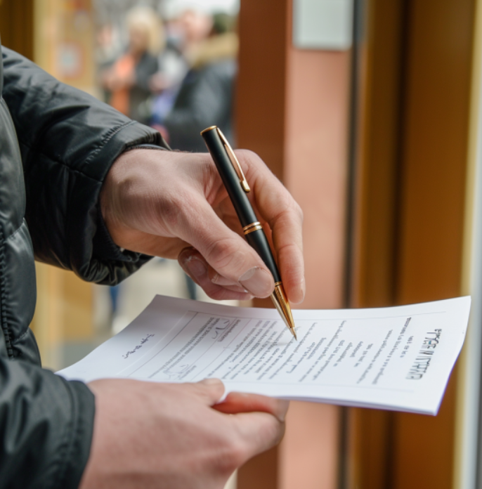
Extension of Diploma
Thesis submission period
1) Make sure that you do not exceeded the max allowed period.
2) Download the MSc Thesis Extension Application Form
3) Fill the form including:
the status of the MSc Thesis
a timeplan for completion
the reason for the extension
4) Sign the form and ask for the signature of your supervisor.
5) Submit the completed form to the MSc program secretariat.
6) Re-register your MSc Thesis for every extra semester you take

Slide 7
Resign from
a MSc Thesis
Download the MSc Thesis Resignement Application Form
Fill it in, sign it, and send it to the MSc program secretariat.

Slide 8
Need a modification to the MSc Thesis?
If a change in the MSc Thesis is needed (i.e. change of title, or supervisor), then before the semester ends and the soonest possible, discuss it with your supervisor. Following, proceed with submitting the MSc Thesis modification application form co-signed by your supervisor (and in the case of supervisor change, by the new supervisor as well)

Slide 9
Completing
the MSc Thesis
Check that MSc Thesis document meets all requirements described in the MSc Thesis Guide (pages/ words/ contents/ refs e.a).
Make sure that similarity percentage is below 20%, as reported by the plagiarism checking tool (TurnitIn).
Send your final version of your MSc Thesis text to your supervisor.

Slide 10
Submitting the
MSc Thesis for evaluation
1) Coordinate with your supervisor on submitting the
MSc Thesis Examination Application Form, (sent by the student) and
MSc Thesis Completion Form (sent by the supervisor).
2) Submit the application within the dates announced by the MSc program secretariat.
3) Be informed about the date/time/place of MSc Thesis examination and defense.

Slide 11
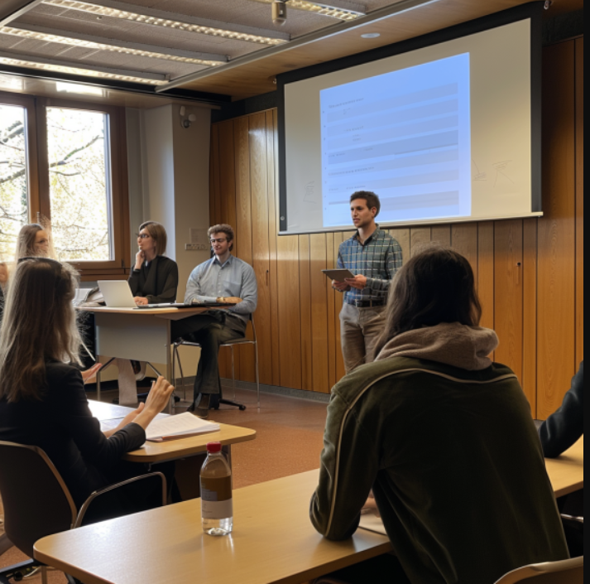
Presenting
the MSc Thesis
1) Prepare your presentation (plan for 20-30 mins presentation).
2) Be ready to answer questions by the evaluation committee.
3) In case of a presentation over the web, make sure that you have the necessary software and hardware to participate in the presentation, as well as an adequate quality of service in your internet connection.
4) If you have a demo, consider producing a video in case presenting a demo is not possible during your presentation

Slide 12
After a successful
presentation
1) Your supervisor and the rest members of your committee must fill in the MSc Thesis Examination Process Form and submit it to the MSc Program secretariat.
2) Wait for your supervisor to send you the signed by the evaluation committee MSc Thesis document.
3) Start your graduation process by submitting the MSc Thesis text to the institution’s repository Polynoe.

